Slide 1
What is RAID--BASICS?
Mylex RAID Primer
A simple guide to understanding RAID

Slide 2

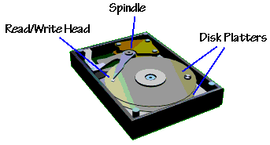

Let's look at a hard disk...
Several platters stacked on top of each other with a little space in between.
One to n platters with a magnetic head on each side all connected rigidly to one spindle.
Hard disk drives store the programs and files with which you work.
The most important program is the Operating System which resides on the hard disk drive.
Every computer ships with at least one hard disk drive

Slide 3
A Single Drive - As RAID sees it
A single physical drive or Multiple physical drives
  JBOD (Just A Bunch Of Disks)
Used as a single system drive (one physical drive)
Used as multiple system drives (more than one physical drive) attached through one or more SCSI or Fibre channels
The RAID controller acts as an intelligent SCSI I/O port
  Benefits include ECC memory, battery backup and other fault tolerant features not available in non-intelligent SCSI I/O port controllers
RAID stands for:
  Redundant Array of Inexpensive/Independent Disks

Slide 4
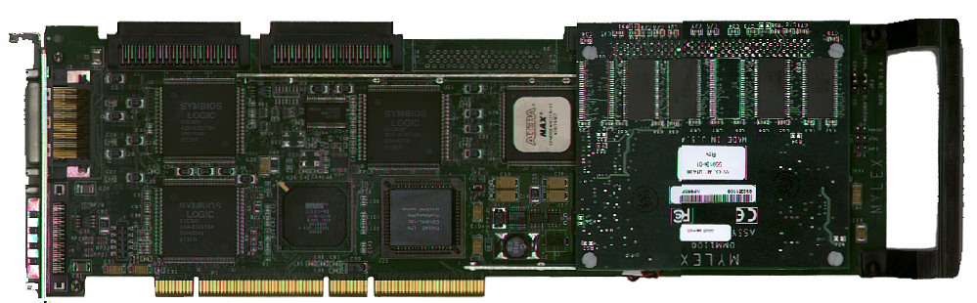
Single Disk (No RAID)
Data Stripes
Disk Drive
eXtremeRAID™ 1100
Example: Data is written to one disk as it is read from system memory.
Disk Drive

Slide 5
RAID Levels
RAID 0
  Striping. Data is striped across multiple disks.
RAID 1
  Mirroring. Data is written identically to a multiple of two disks simultaneously.
RAID 3
  Striping with Parity. Data is striped across multiple disks and parity is written to one additional disk.
RAID 5
  Data and parity are written across multiple disks simultaneously.

Slide 6
RAID Applications
Transfer Rate Intensive Applications: (Typically RAID 0 environments)
RAID striping is ideal for transfer rate-intensive environments
A transfer rate-intensive environment consists of :
  Applications that require a large amount of data to be processed in a fixed amount of time
  Video playback and video editing are typical transfer rate-intensive environments
  Photo processing, manipulation and rendering
Request Rate Intensive Applications: (Typically RAID 5 environments)
RAID is used in highly multi-tasking, request rate-intensive environments
A request rate-intensive environment consists of:
  databases, file/web servers: -- high number of random smaller requests.
A RAID drive can be configured to process each request within a stripe, allowing multiple requests to be processed in parallel.

Slide 7
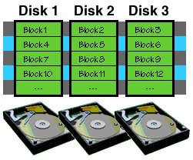
RAID 0 - Striping
RAID 0 uses disk striping.
Multiple hard disks used to form a logical drive.
Hard disks are striped using the stripe size specified during configuration.
A request less than the stripe size is sent to one hard disk. A request greater than the stripe size is divided into multiple requests and sent to multiple disks, in parallel.
Typically used in data rate intensive applications (video editing) Consider a three-drive RAID with a predefined stripe size of 32K. A 72K request
Example: Consider a three-drive RAID with a predefined stripe size of 32K. A 72K request would be broken up into three chunks of
32K, 32K, and 8K, with the first 32K going to one drive, the next 32K going to the next drive, and the last 8K going to the
third drive. Each of these requests would be sent in parallel to the three drives to be serviced simultaneously.

Slide 8
RAID Level 0 - Disk Striping
Data Stripes
Disk Drive
eXtremeRAID™ 1100
Example: Data split in equal chunks and is written to multiple disks in parallel. The data transfer rate is the aggregate sum of all the drives
available in the array minus any overhead.

Slide 9
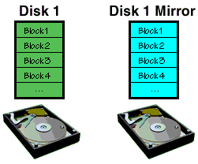
RAID 1 - Mirroring
RAID 1 provides the highest level of fault tolerance to a single drive
  duplicates each I/O request to a secondary mirror hard drive.
RAID 1 requires a multiple of two drives -- the primary set and the mirror set.
Mirroring is suited for any application where protection from drive failure is required.
  Mirroring allows two drives to mirror on the same channel or "duplex" across two channels/two host adapters.
  The mirror drive must be equal or greater in capacity than the primary drive
  In case of a drive failure, all I/O requests are re-directed only to the remaining good drive
  Used to store only the important data from applications
  Also used to protect the main drive where applications are installed
  Provides immediate disaster recovery when a drive fails.

Slide 10
RAID Level 1 - Disk Mirroring
Data Stripes
Disk Drive
eXtremeRAID™ 1100
Example: Data is copied and written to an identical drive in parallel. This provides a redundant configuration for disaster recovery.

Slide 11
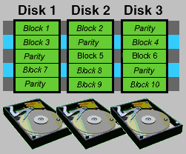
RAID 3 and RAID 5
RAID 3 and 5 stripes data across multiple drives and adds parity for fault tolerance.
RAID 3 writes all parity information to one single drive.
Mylex RAID 5 controllers implement “rotational parity” for increased drive reliability and reduced “single point of failure”.
RAID 5 is the predominant highly available, fault tolerant RAID level used in servers today.
RAID 5 applications include OLTP (online transaction processing), file server and web server applications requiring 24/7 up-time.
RAID 5 Array
Example: Consider a three-drive RAID 5 set. Each block or “stripe” of data is split across as many drives (n-1) as will fit. The remaining drive contains the parity information to re-construct the previously written striped data in case of a failure. The parity block is rotated amongst all the drives so that one single drive does not get accessed more than any other drive.

Slide 12
RAID 5 -
Disk Striping w/ rotational Parity
Data Stripes
Parity Stripes
eXtremeRAID™ 1100
Disk Drive
Example: Data is split in equal chunks and is written to multiple disks in parallel. The remaining drive contains the parity information to re-construct the previously written striped data in case of a failure. The parity block is rotated amongst all the drives so that one single drive does not get accessed more than any other drive.

Slide 13
RAID 00, 10, 30, 50
Provides Multi-layer RAID configurations
Ideal for TPCC configurations
Multiple RAID Level 0, 1, 3, or 5 Arrays can be “striped” together to create RAID Levels 00, 10, 30, or 50
  Provides more capacity
  Often referred to as ‘Spanning’
Provides better I/O load balancing
RAID 50
RAID 5
RAID 5
RAID 5
Example: Three RAID 5 arrays are “striped “ together for added capacity and as a means to add additional drives to a large array.

Slide 14
RAID Controllers
Low Cost RAID for Desktops and Entry-level Servers
  0 or 1 channel PCI-to-Ultra2 SCSI RAID
  examples: Mylex AcceleRAID Series
High Performance RAID for Mid-level to High-end Servers
  Up to 3 channel PCI-to-Ultra SCSI & PCI-to-Ultra2 SCSI RAID; up to 128MB cache; ECC (some models)
  examples: Mylex eXtremeRAID Series
External RAID for enterprise level servers
  2 channel Fibre to 4 Ultra2 SCSI RAID; 256MB mirrored cache
  examples: Mylex DAC-FL Series

Slide 15
RAID Advantages!
RAID provides an environment of highly reliable, fault tolerant disk drive sub-systems
RAID adds life to disk drives as the controller manages the I/O load equally amongst all the drives in the Array reducing the risk of “single-point-of-failure”
A “successful” RAID environment includes reliable robust disk drives
Each RAID environment will include multiple disk drives
Mylex PCI RAID controllers can attach as many as 45 drives per RAID controller, up to 16 controllers per system for an astonishing -- 720 disk drives per system configuration
Mylex external RAID controllers can attach as many as 90 drives per storage subsystem and can reside as part of a SAN (Storage Area Network)
Capacities range from terabytes to petabytes!

Slide 16
Where can I use RAID?
LANs/WANs
SANs
Clustering environments
Mission critical installations
News centers
Internet News Servers
Enterprise Servers
Performance Desktop Systems
PC Workstations
Workgroup/File Servers
E-Mail Servers
Intranet/Web Servers
Application Servers

Slide 17
MYLEX RAID
Broadest line of RAID controllers in the world
  Low Cost RAID for Desktops and Entry-level Servers
  High Performance RAID for Mid-level to High-end Servers
  External RAID for Enterprise-class Servers
Strategic relationships with industry leaders
  Intel, Microsoft, System vendors, Drive vendors & Software suppliers
Mylex has the world’s fastest RAID Controller
Partner with 7 of the top 10 server OEMs
Leading RAID supplier in the channel
Over 1,000,000 Mylex RAID controllers in the field
Mylex rated #1 in non-captive market share by IDC, DataQuest & Disktrend ---- 1998
Mylex is synonymous with RAID

Slide 18
Mylex RAID for All Server Solutions
AcceleRAID™ Series: Cost Effective PCI RAID Solutions for:
    Entry-level Servers
    “Win/tel”-based Workstations
    High-end Desktop Systems
eXtremeRAID™ Series: High Performance PCI RAID Solutions for:
    Mid-level Servers
    High-end Servers
DAC Series: External RAID Solutions for:
    Enterprise-class Servers
    Clustering and High Data Availability Applications
    Storage Area Networks

Slide 19
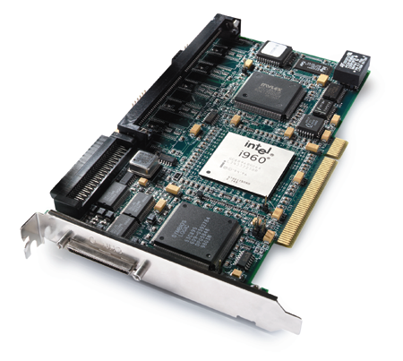
AcceleRAID™ Technology
RISC -i960
Ultra2 SCSI
Low Cost
0 or 1 Ultra2 SCSI Channels
Up to 4MB Flash EEPROM
Up to 128MB MB EDO RAM w/ECC
Up to 1 int. + 1 ext. SCSI connectors
PCI 2.1 compliance
PCI Hot Plug
RAID 0, 1, 0+1, 3, 5, 10, 30, 50, JBOD
Also used in Systems with a PCI slot dedicated for add-in RAID controllers, providing 1 SCSI channel in addition to the number of channels on the Motherboard (AcceleRAID™ 250)

Slide 20
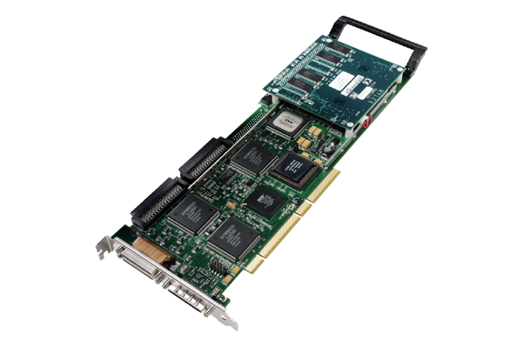
eXtremeRAID™ Technology
233 MHz SA 110, Ultra2 SCSI,
64-bit PCI
2 or 3 Ultra2 SCSI Channels
Up to 4MB Flash EEPROM
32 or 64 MB parity SDRAM + BBU module
Up to 3 internal and 3 external SCSI connectors
PCI 2.1 compliance
Dual Address Cycle
PCI Hot Plug
> 6000 Random I/O’s
> 75 MB/second sustained data transfer rate

Slide 21
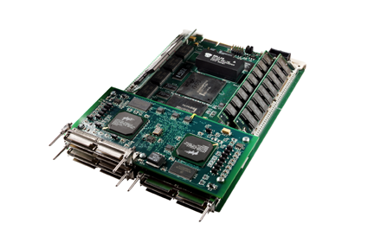
DAC-FL: Technology
Two RISC Processors, 2Fibre Channel loops, Ultra2 SCSI
Up to 256 MB Data Cache
Dual PCI Bus design
5 1/4” form factor
2 Copper FC-AL host channels
Burst cache transfer rates: Up to 97 MB/s per host channel
4 Ultra2 SCSI LVD channels
15 devices per Ultra2 SCSI channel - 60 devices/controller
Up to 1.08TB per controller
Sustained disk transfer rates: over 52MB/s

Slide 22
DAC-FF: Technology
Up to 256 MB Data Cache
Dual PCI Bus design
5 1/4” form factor
2 Copper FC-AL host channels
Burst cache transfer rates: Up to 189 MB/s
4 Fibre channels to drives
125 devices per Fibre channel - 500 devices/controller
Up to 9.0TB per controller
Two RISC Processors, 2Fibre Channel to host, 4Fibre Channels to drives

